Slide 1
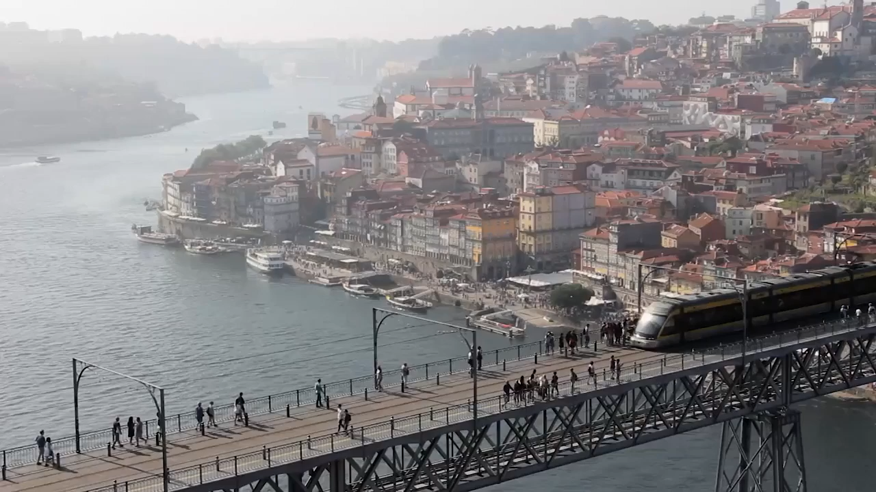
POCKETMETRO
METRO DO PORTO
GROUP 10
Notes:
- So today we’re going to walk through our take on the Metro do Porto

Slide 2




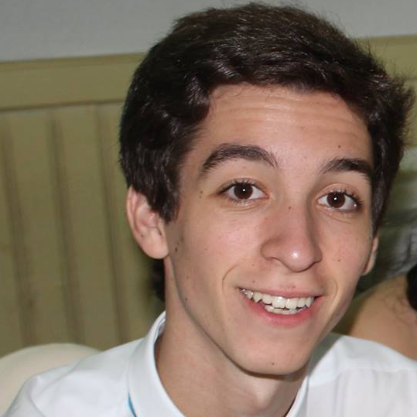
GROUP 10
Rodrigo Oliveira
João Pina
João Nogueira
Miguel Regouga
José Pinto
Front-End Developer
Designer
Project Manager
User Researcher
Back-End Developer
Notes:
- This is our team, I am Miguel, this is João and the rest of the team is behind

Slide 3
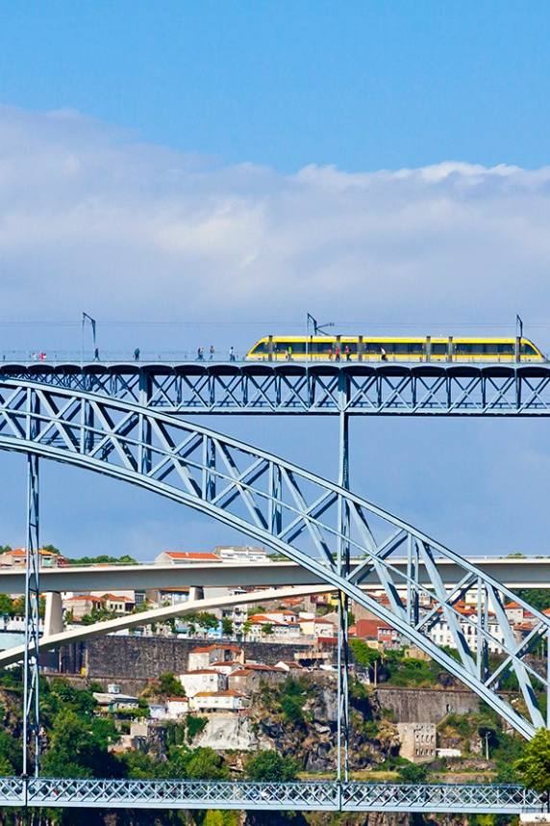
Light rail network
First line opened in 2002
Pioneer in architectural design
Lack of physical barriers
Proof-of-payment system
Notes:
So, about the Metro do Porto itself

Slide 4
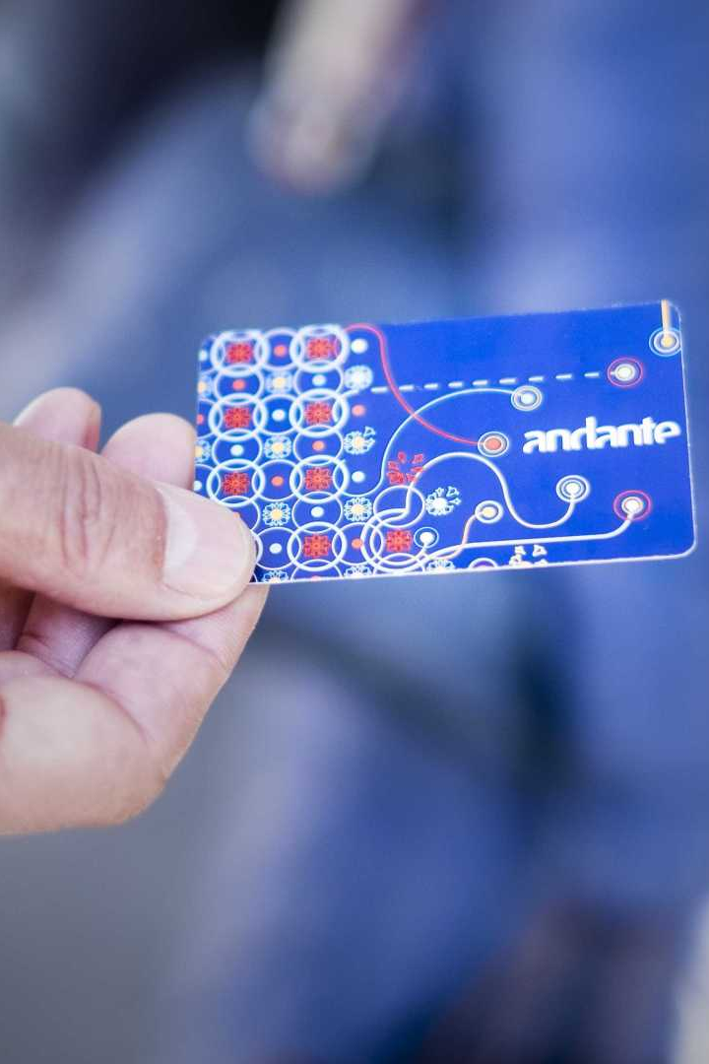
Validated occasional ticket
Gold passes
Andante 24
Notes:
Metro do porto has three types of tickets

Slide 5
Notes:
- Ridership in metro do porto has been increasing, so has the monthly infractions

Slide 6
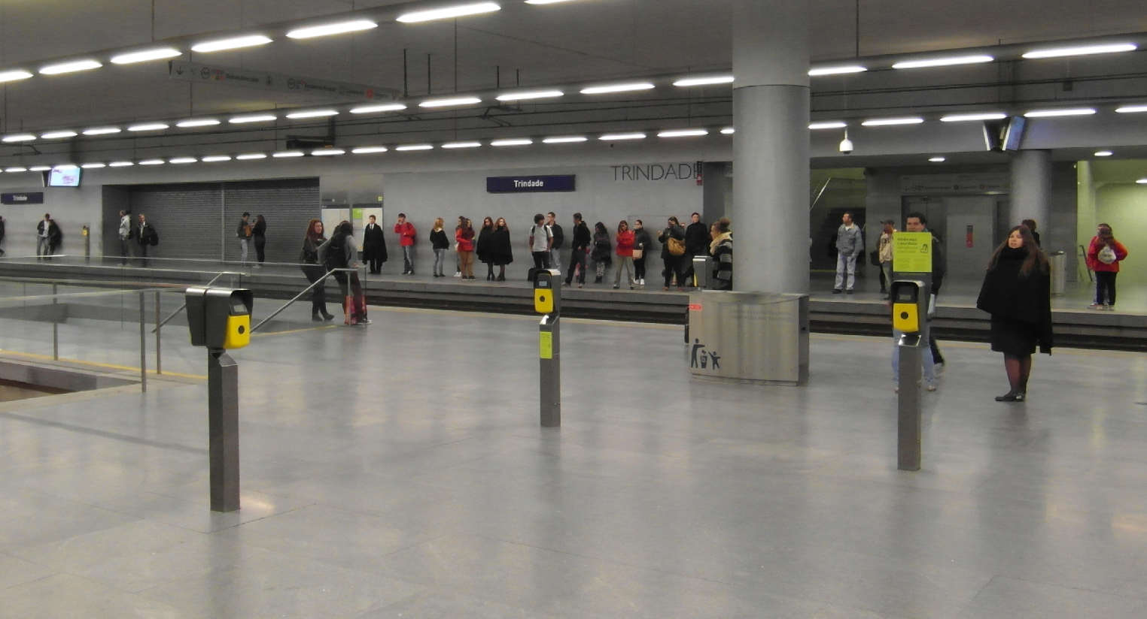
NO PHYSICAL BARRIERS!
Notes:
As i told you, metro do porto does not have physical barriers, so this is a typical view of when you enter the metro. As a passenger, you need to validate the ticket

Slide 7
Why isn’t this FOOLproof?
Notes:
We can divide this problem into two different chunks

Slide 8


Slide 9



Notes:
Discussion, Observation, Inquiring Users

Slide 10
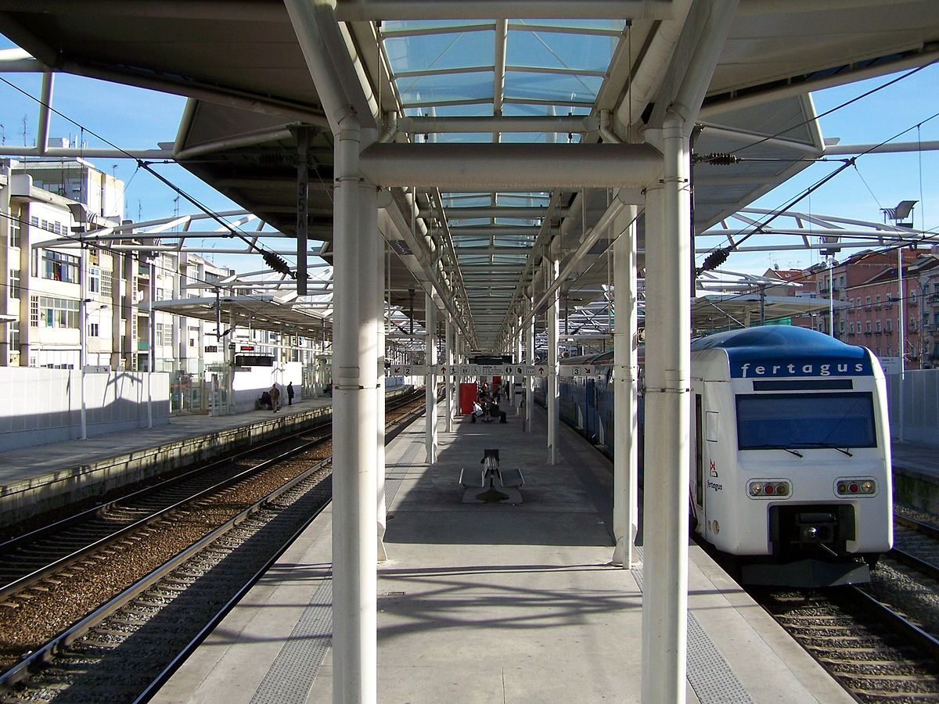
Roma-Areeiro station

Slide 11
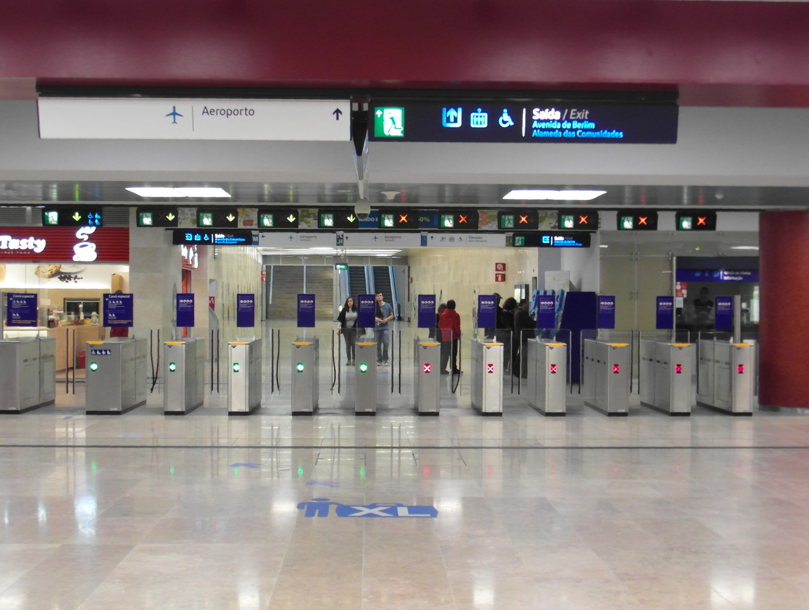
Metro de Lisboa

Slide 12
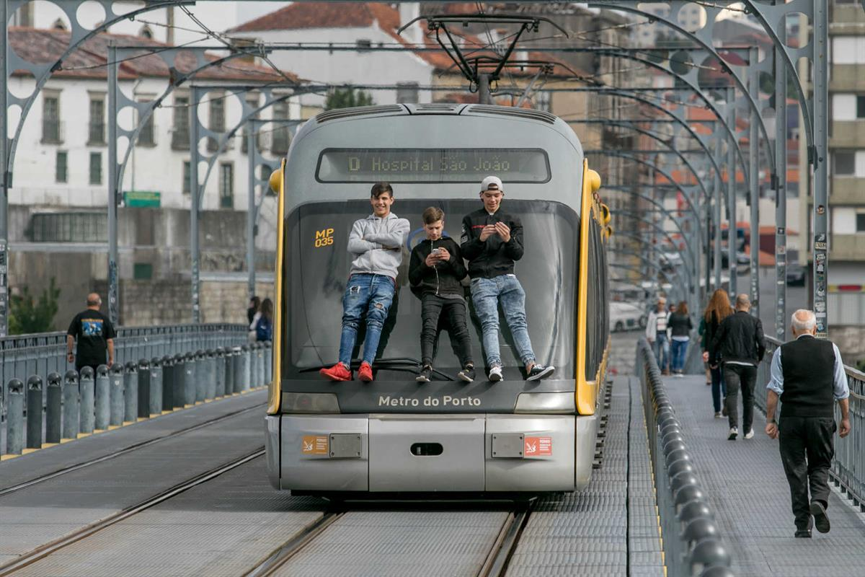
Age of the questioned

Slide 13
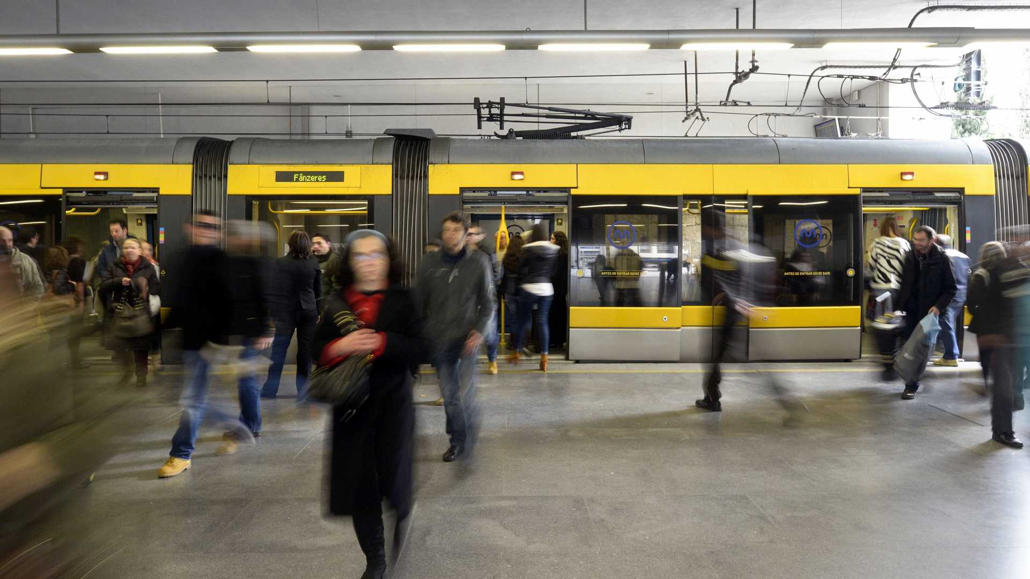
How often do you validade your ticket?

Slide 14
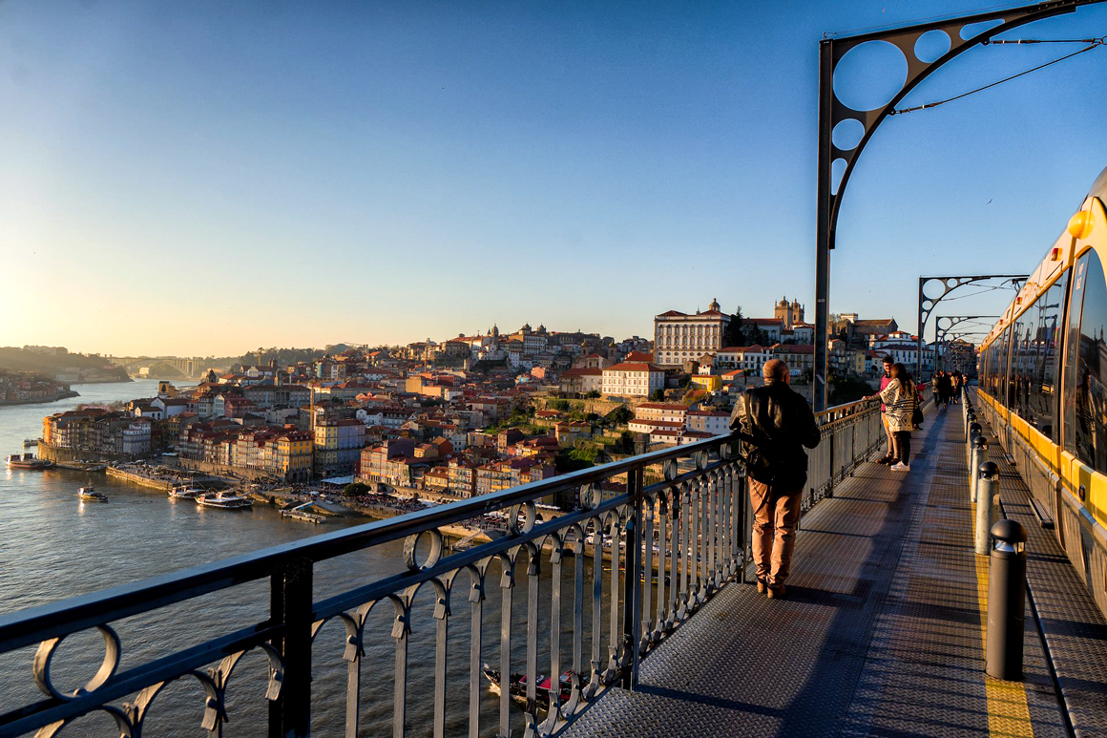
Why didn’t you buy or validate your ticket?
App?
SENSORS?
loyalty?

Slide 15
Passengers
Metro
Notes:
These two parts combined make up the “perfect” crime, which is what we’re trying to tackle.

Slide 16
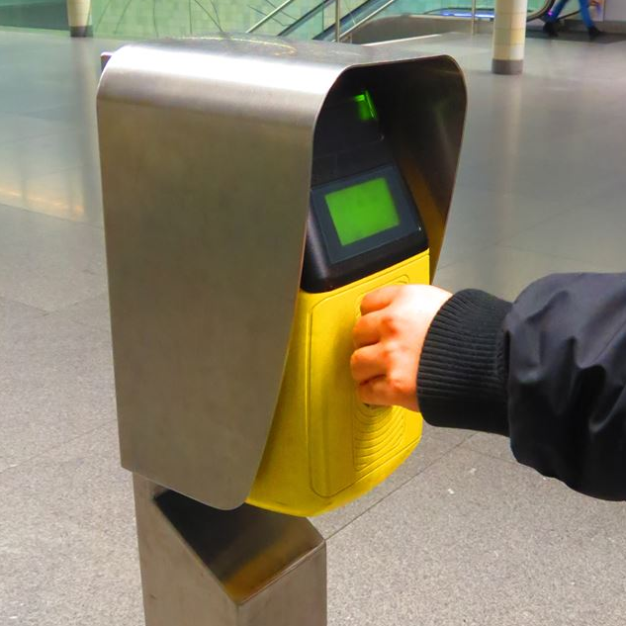
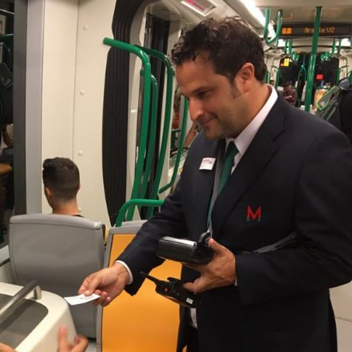
Metro
Notes:
The metro part, the lack of physical barriers combined with few inspections

Slide 17
Passengers
Metro
Notes:
These two parts combined make up the “perfect” crime, which is what we’re trying to tackle.

Slide 18
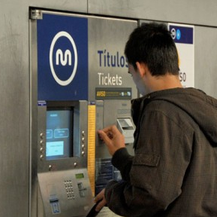
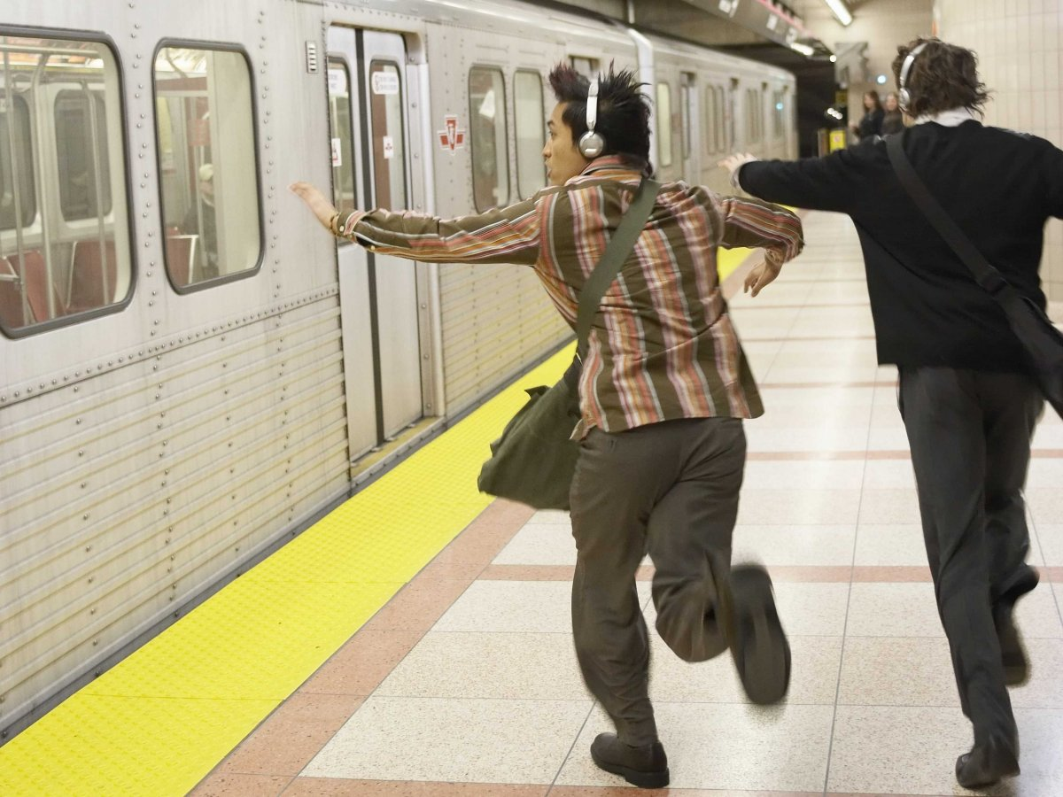
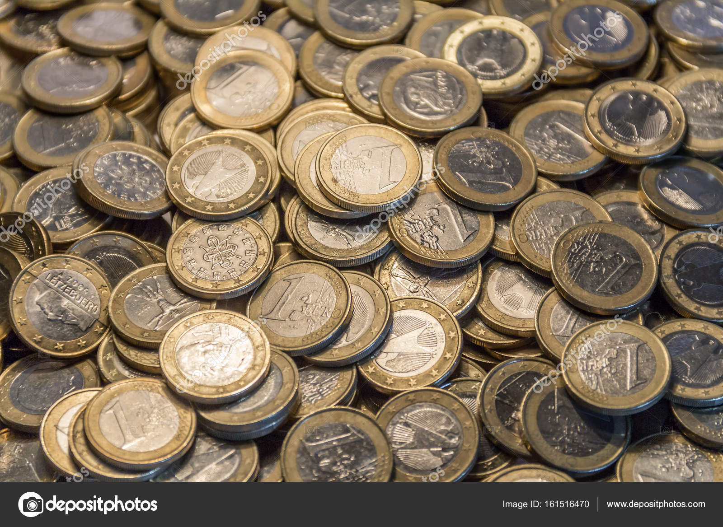
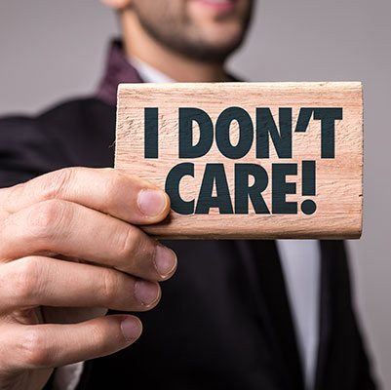
Passengers
Notes:
The passenger’s part, as they may have:
some trouble understanting the ticket machine
May be in a hurry and don’t have time to buy the ticket or to validate
You may be in a lack of coin changes
Or you may simply don’t care

Slide 19
Passengers
Metro
Notes:
These two parts combined make up the “perfect” crime, which is what we’re trying to tackle.

Slide 20
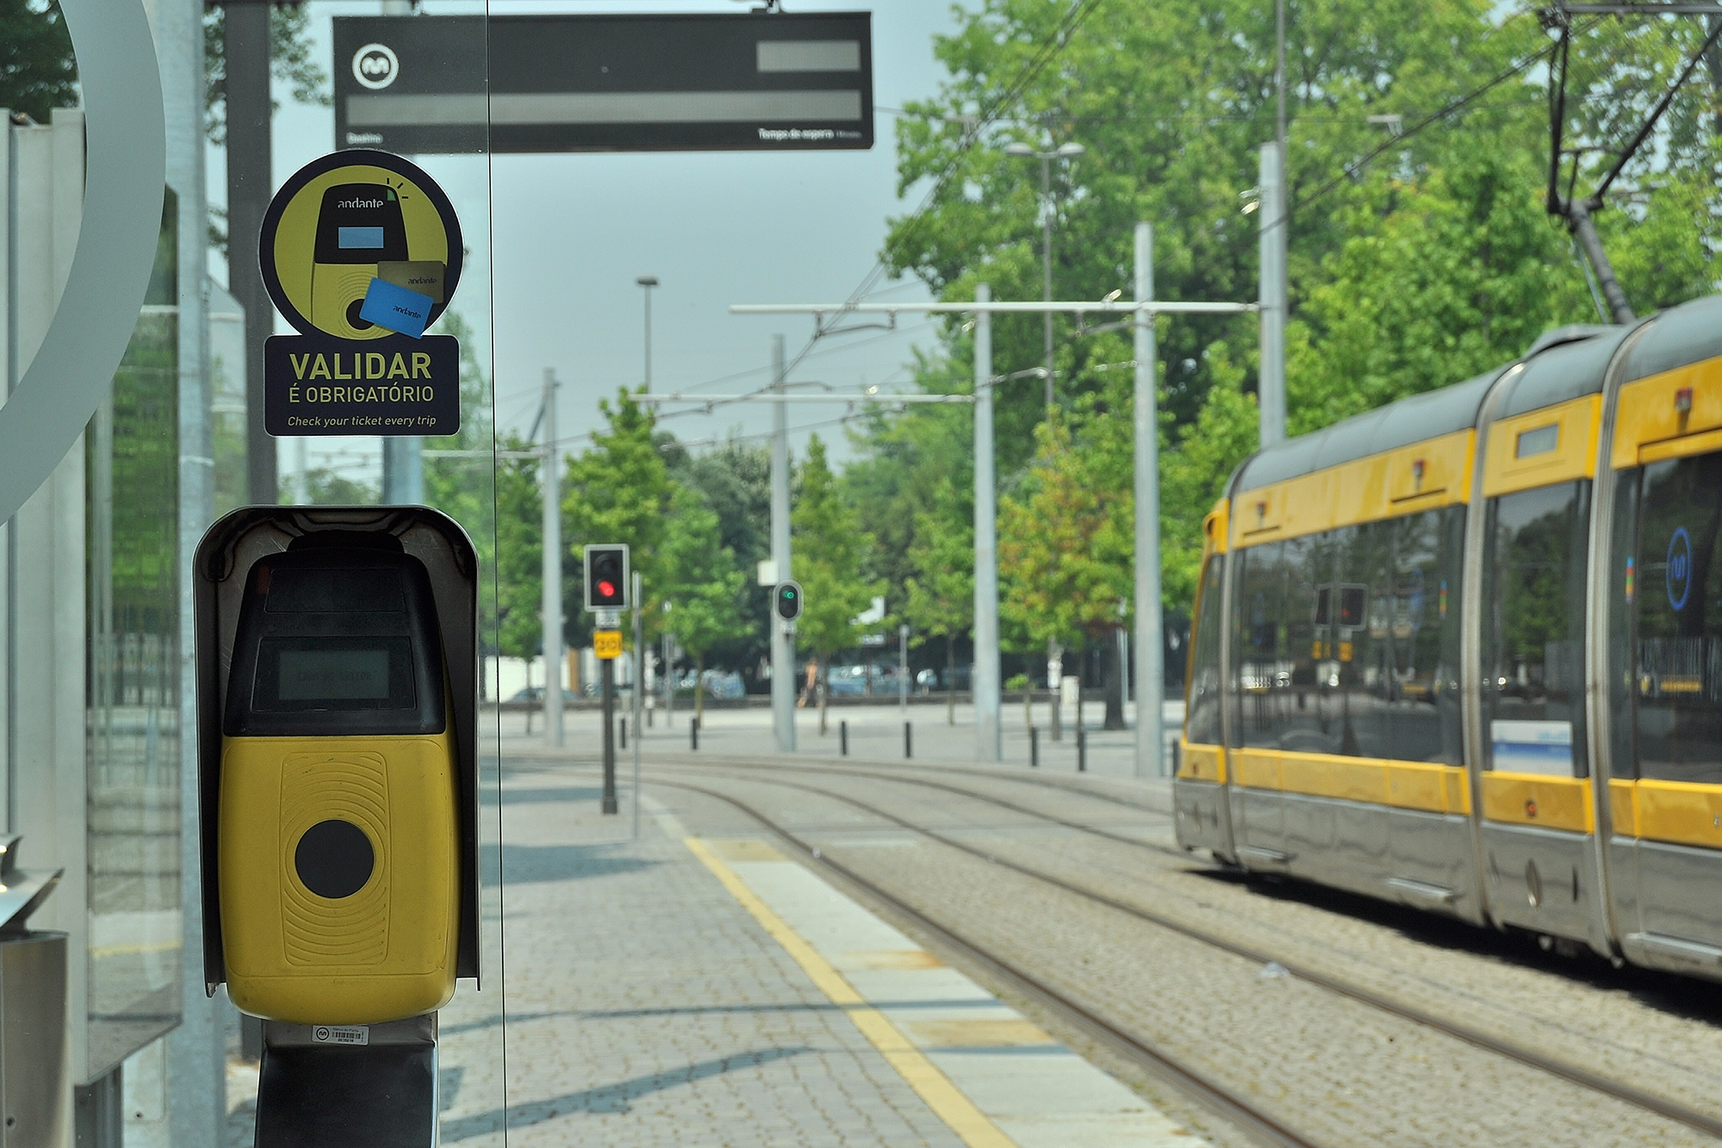


Notes:
While thinking in a solution for this, we thought:
One one hand, we want to encourage the users who want to validade to do it, and reward them those who do

Slide 21
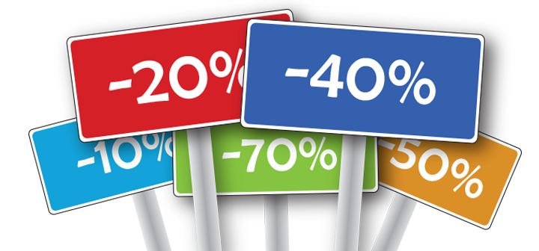
PEOPLE LOVE DISCOUNTS!
Notes:
So we thought, why not offer discounts for people who validate?

Slide 22
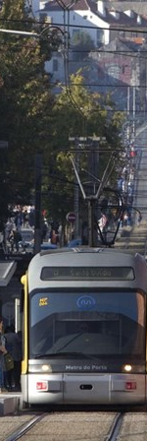

Discount on a Francesinha?
Notes:
For example, discounts in a francesinha?

Slide 23
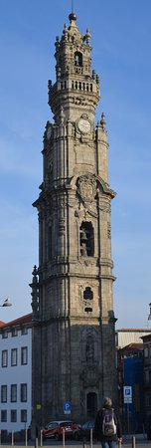
Discount to climb the Torre dos Clérigos?
Notes:
Or to climb the torre dos clérigos?

Slide 24
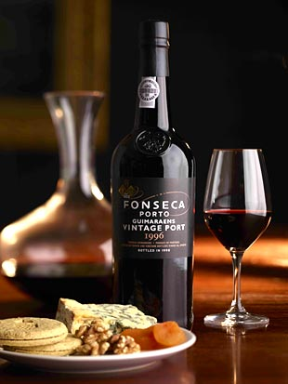
Discount on Port Wine tasting?
Notes:
Or to taste some delicious port wine?

Slide 25
Free rides on the Metro?
Notes:
Or even free rides on the metro?

Slide 26
Notes:
These discounts would encourage people who don’t validate or pay their ticket to do it

Slide 27
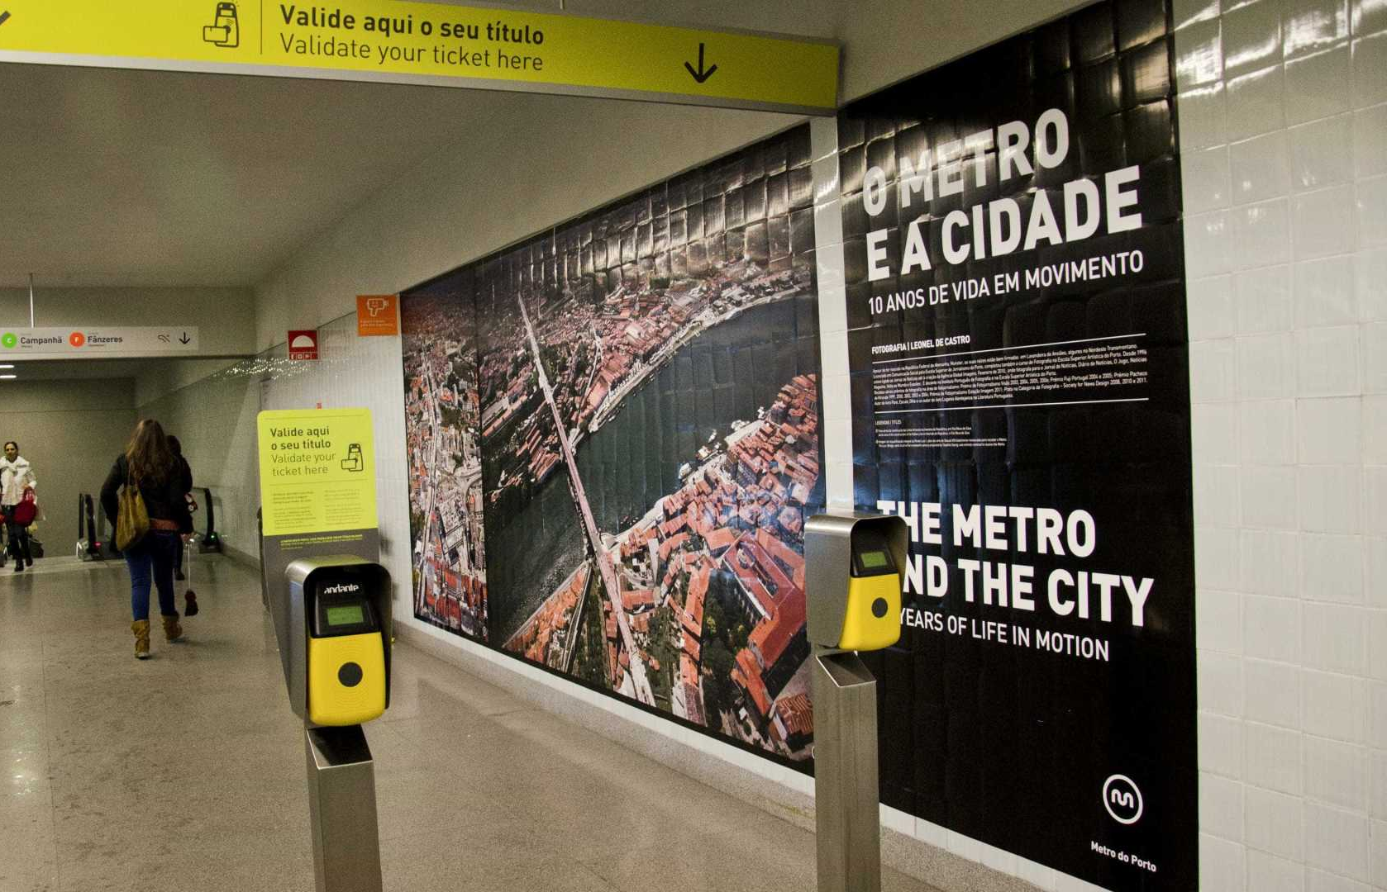

Notes:
- But on the other hand, we want to stop people who forget or don’t want to validate, in an informative way

Slide 28
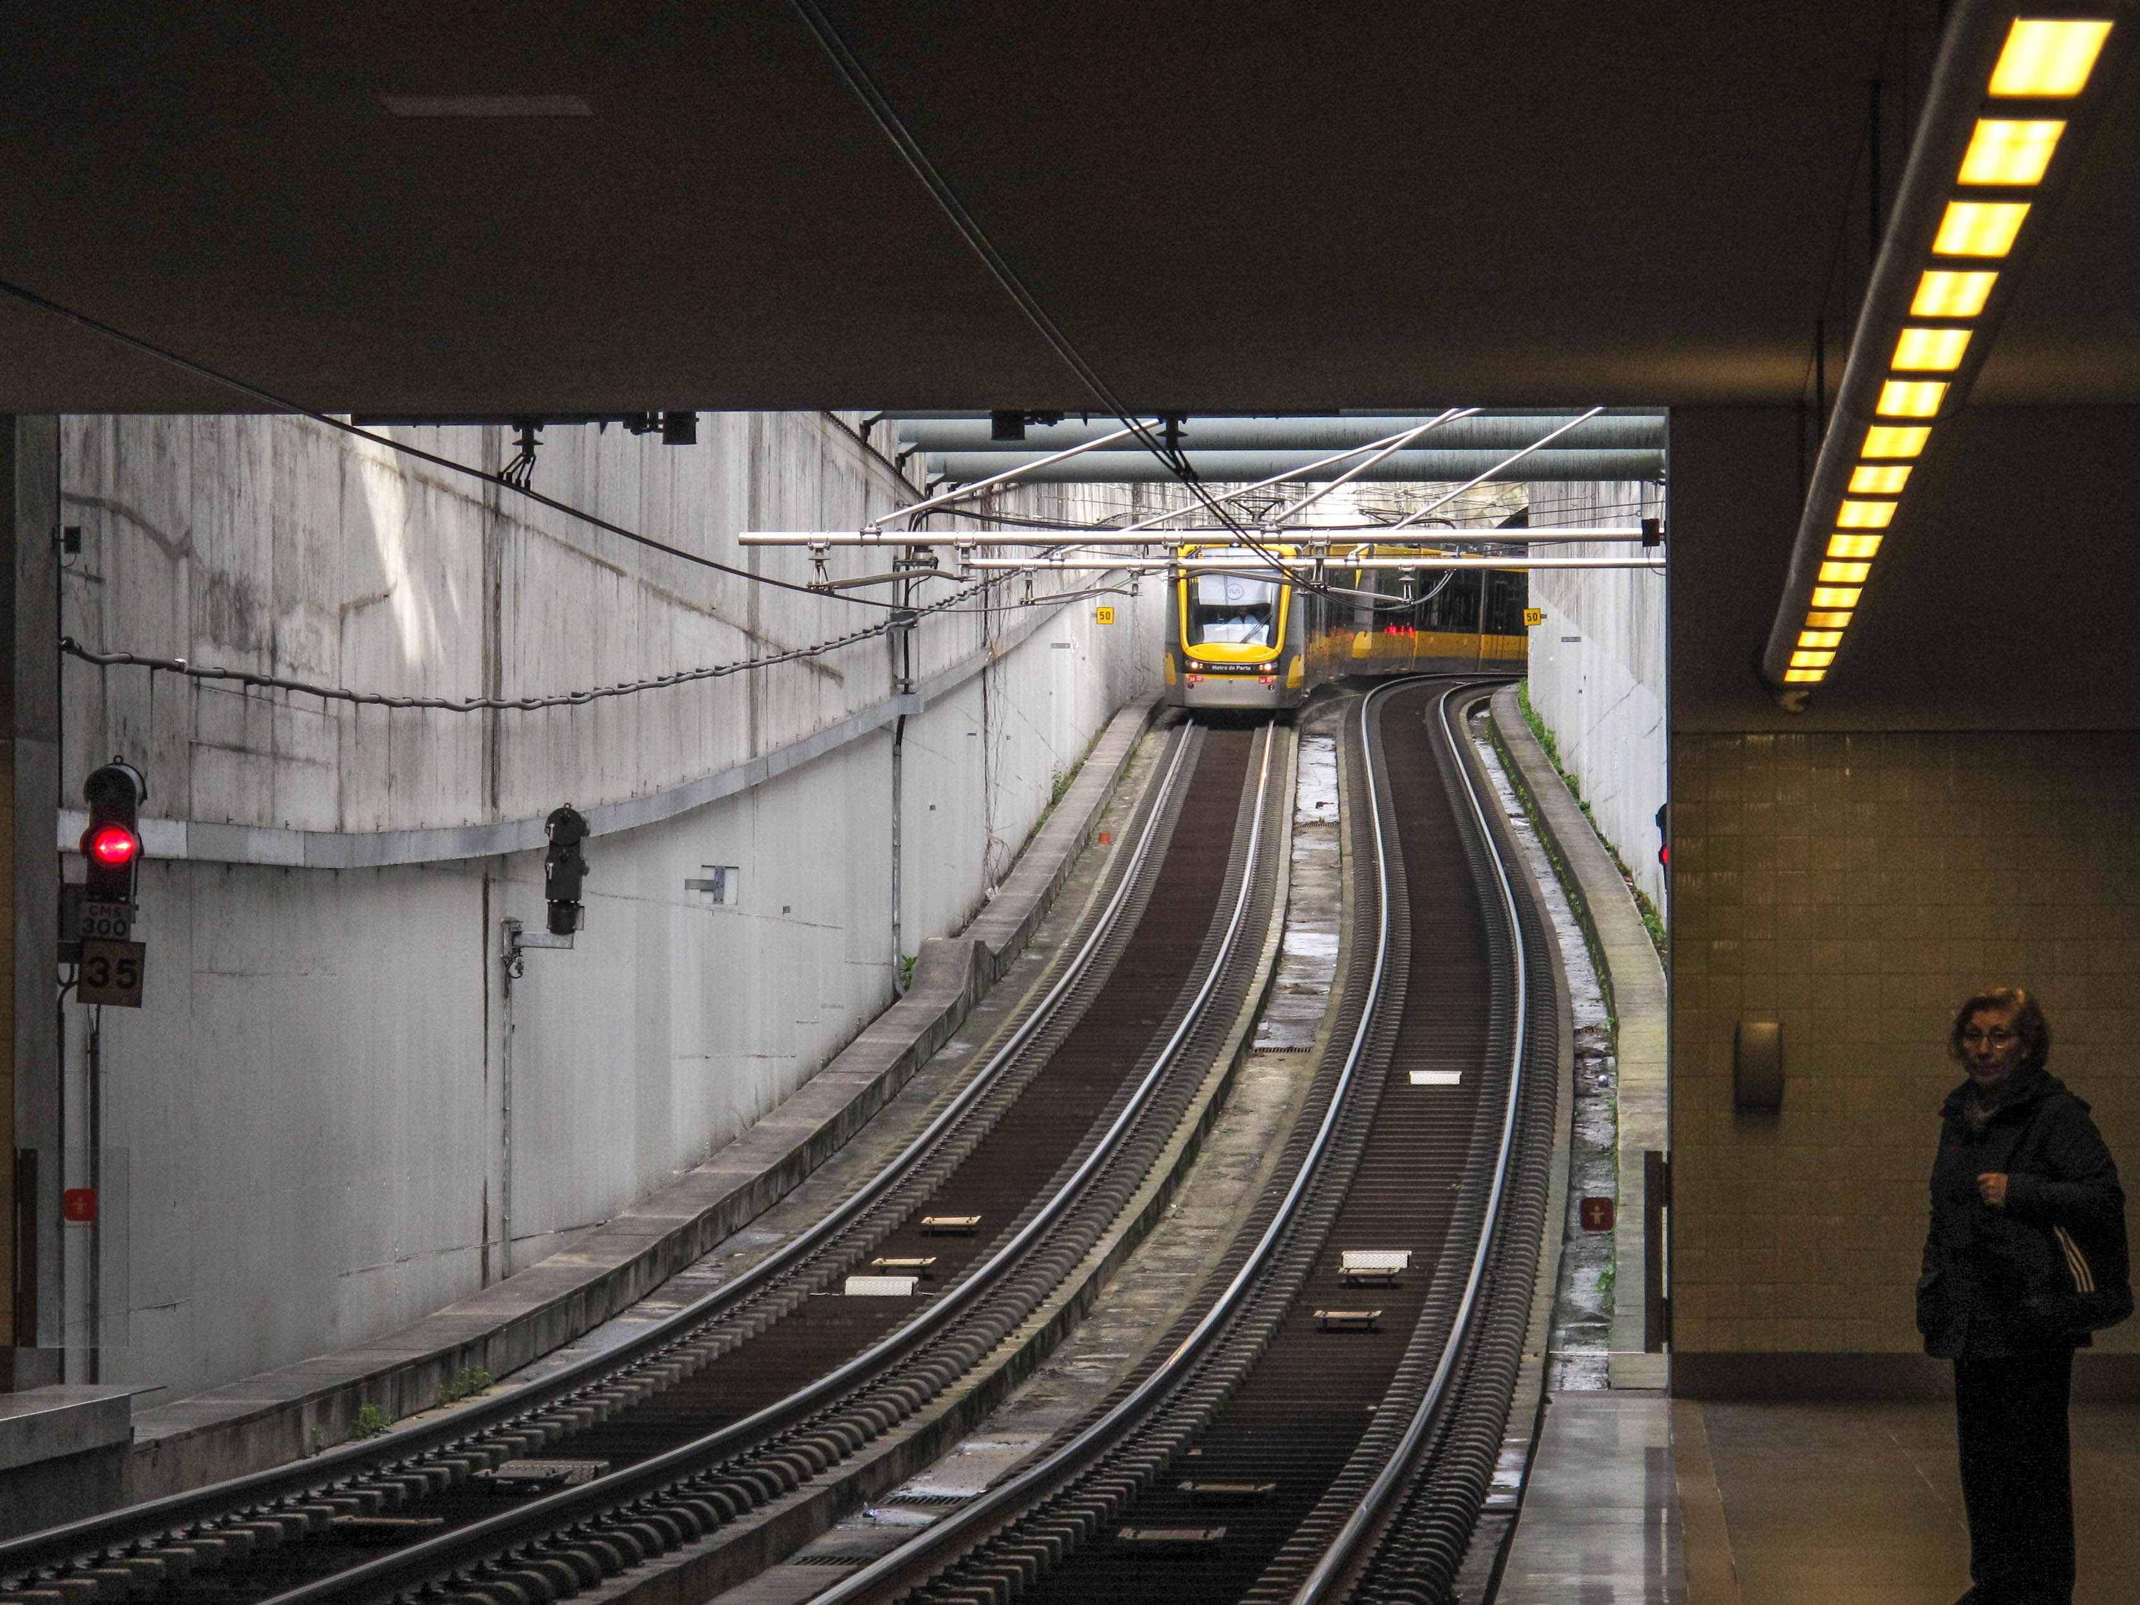
Notes:
- so that a passenger knows when he needs to validate in order to enter the train

Slide 29
THE SOLUTION

Slide 30
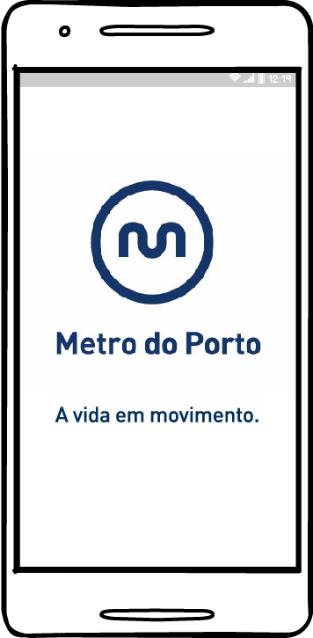

THE SOLUTION
Notes:
Two part solution
Negative & positive reinforcement

Slide 31
Tagging camera-assisted mechanism
that can identify a person and a receiver that checks if the card is emitting any signal that says it's validated
Notes:
We want a system that can distinguish multiple individuals and checks if each one is emitting a “validated signal”
Would reduce ticket inspectors’ costs, but would increase maintenance costs
Negative reinforcement part

Slide 32
THE SOLUTION

Slide 33
REMAKE OF THE MOBILE APP
to feature a redesigned and simpler user-interface, as well as the inclusion of a new “milestone" / loyalty system
Notes:
Being in the XXI century, the mobile app is a vital part of any product and we think an upgrade or even a overall remake is need

Slide 34
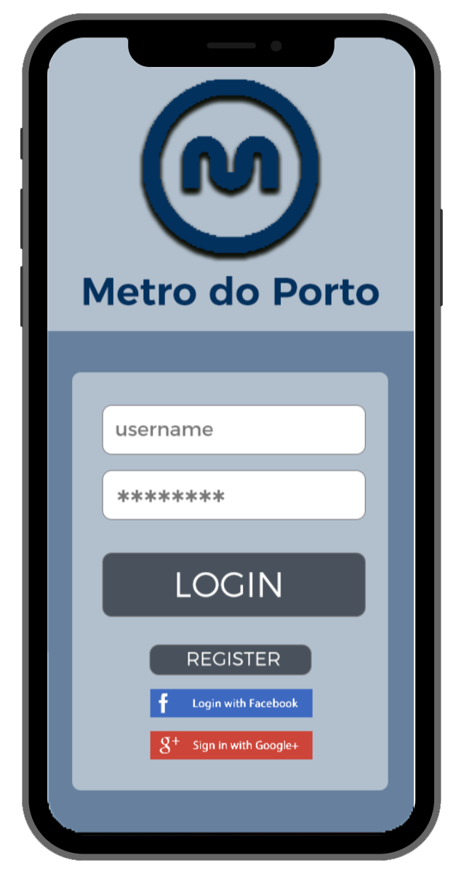
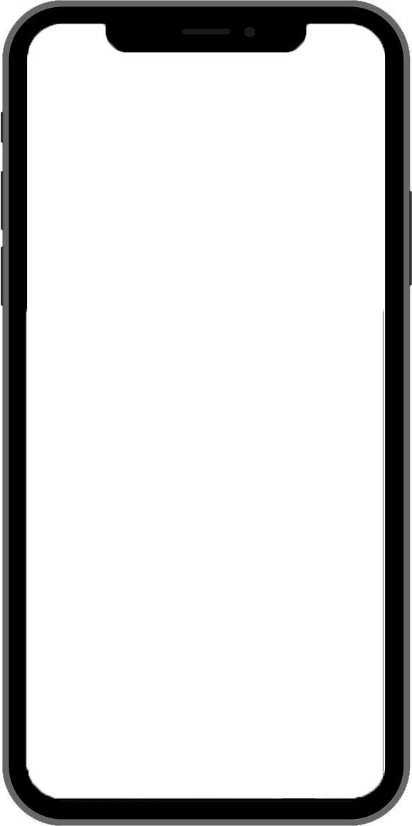
Low fiDELITY prototYPE

Slide 35
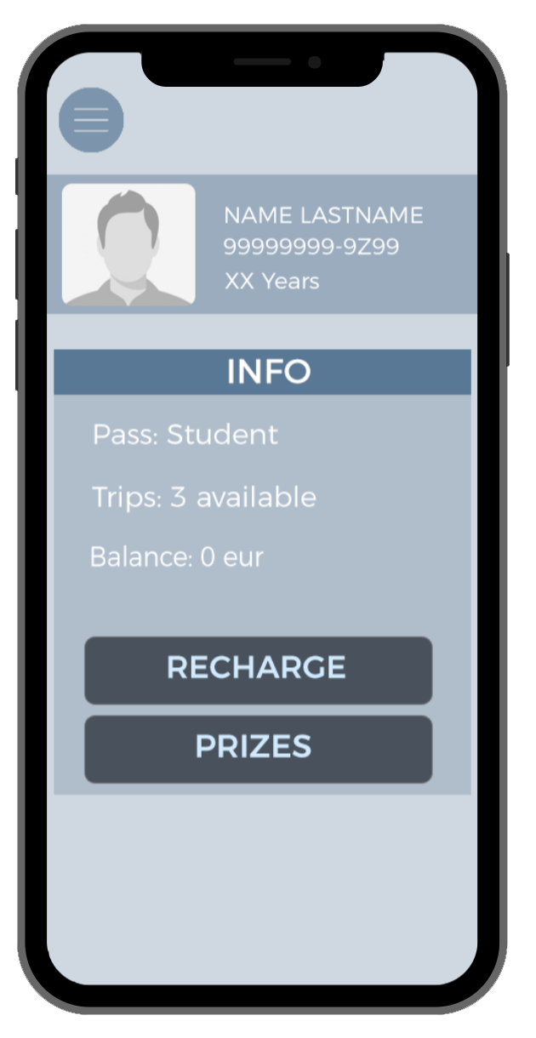
Low fiDELITY prototYPE

Slide 36
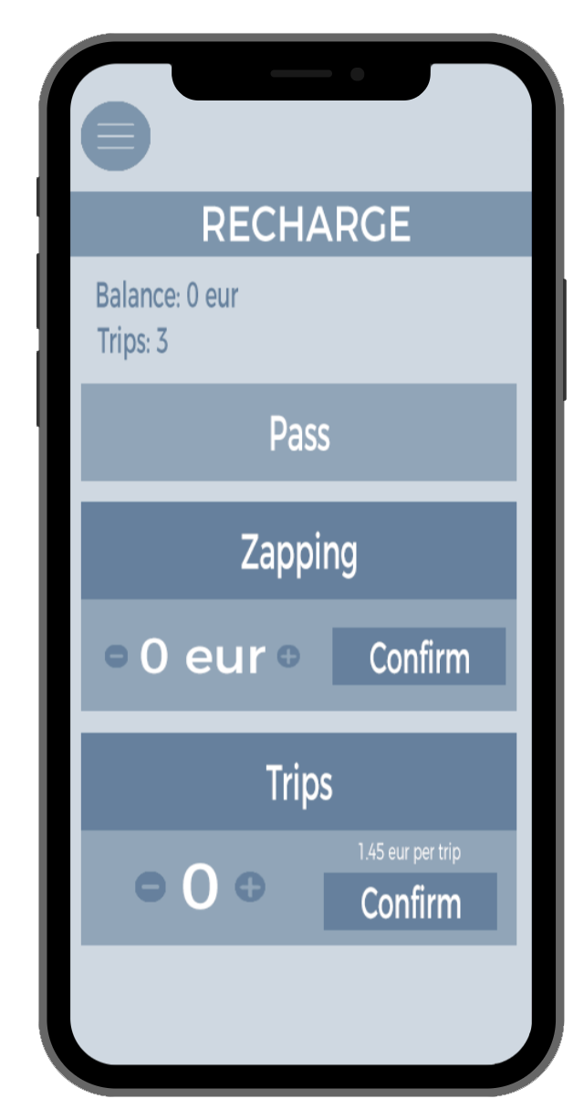
Low fiDELITY prototYPE

Slide 37
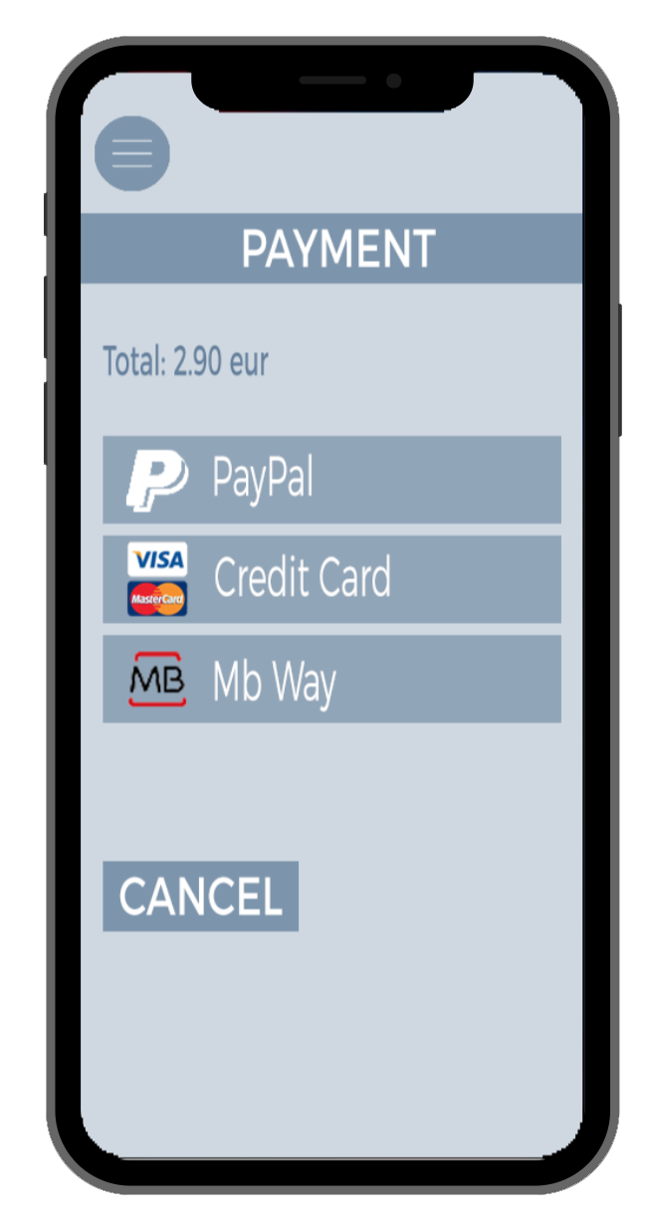
Low fiDELITY prototYPE

Slide 38
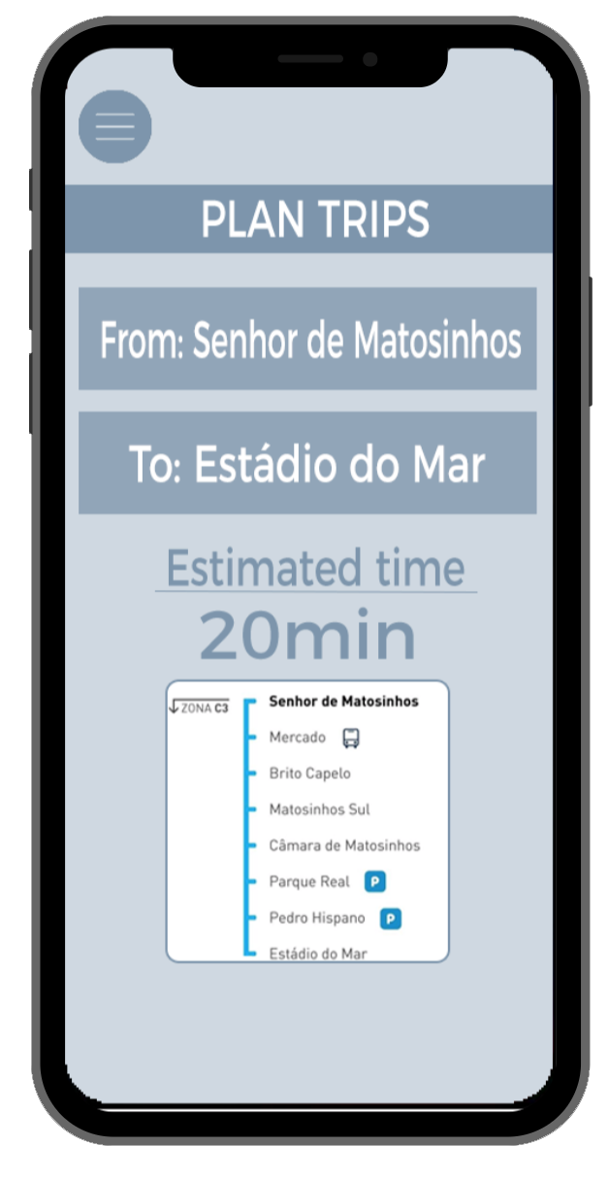
Low fiDELITY prototYPE

Slide 39
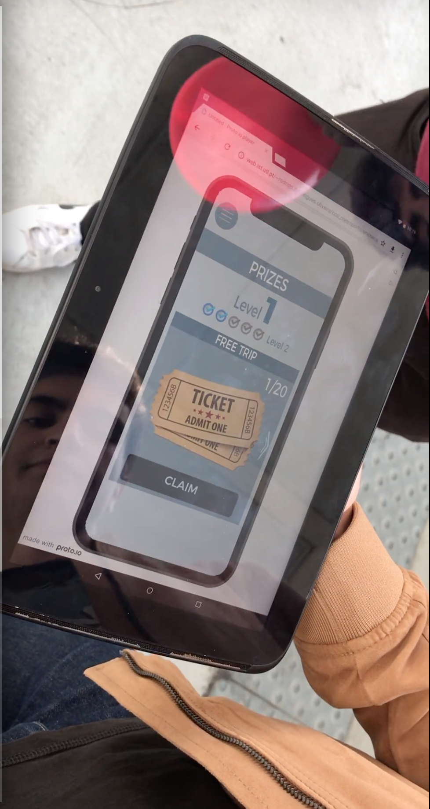
Low fiDELITY prototYPE
FORMATIVE USER TESTING AND STUDY

Slide 40
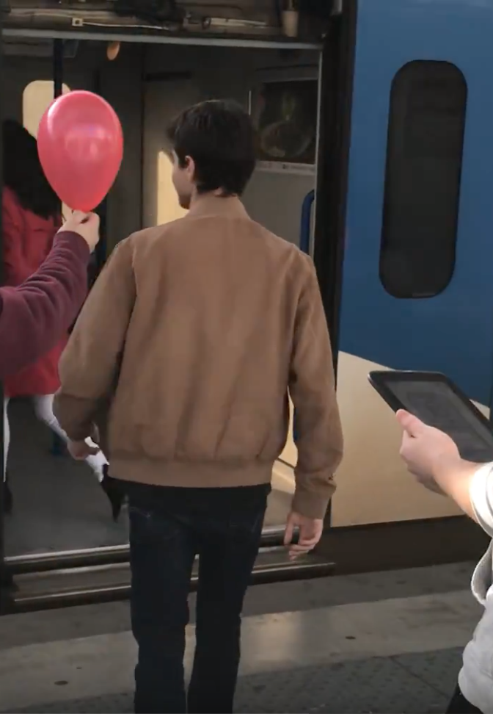
Low fiDELITY prototYPE
FORMATIVE USER TESTING AND STUDY

Slide 41
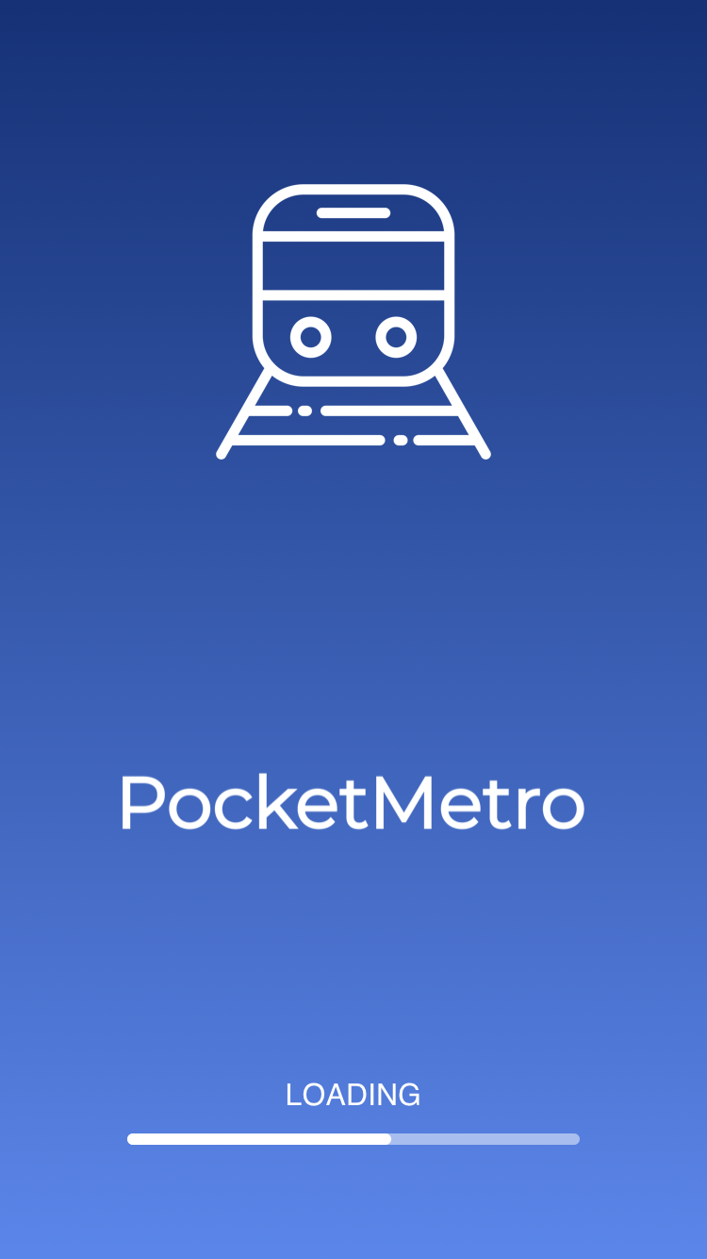
Low fiDELITY prototYPE
FORMATIVE USER TESTING AND STUDY
FUNCTIONAL PROTOTYPE

Slide 42
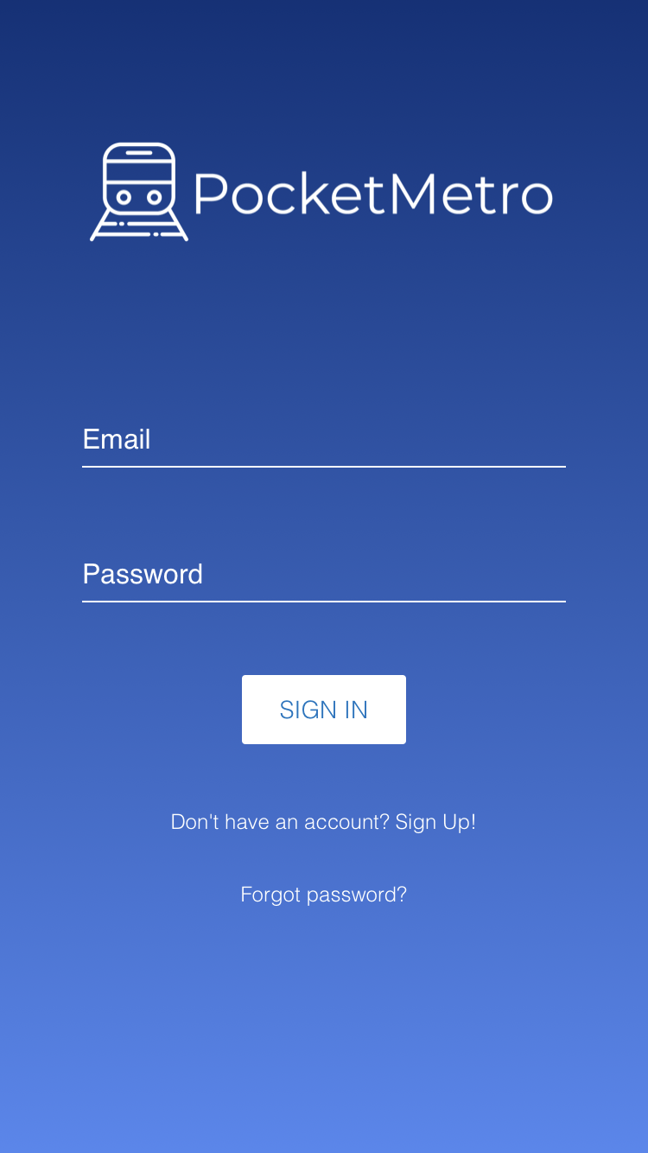
Low fiDELITY prototYPE
FORMATIVE USER TESTING AND STUDY
FUNCTIONAL PROTOTYPE

Slide 43
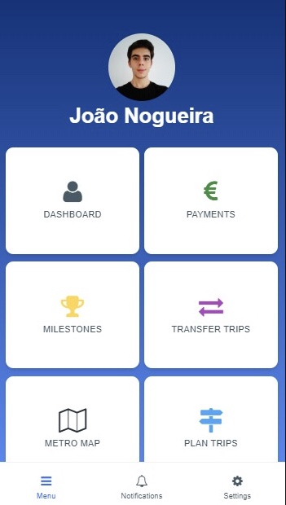
Low fiDELITY prototYPE
FORMATIVE USER TESTING AND STUDY
FUNCTIONAL PROTOTYPE

Slide 44
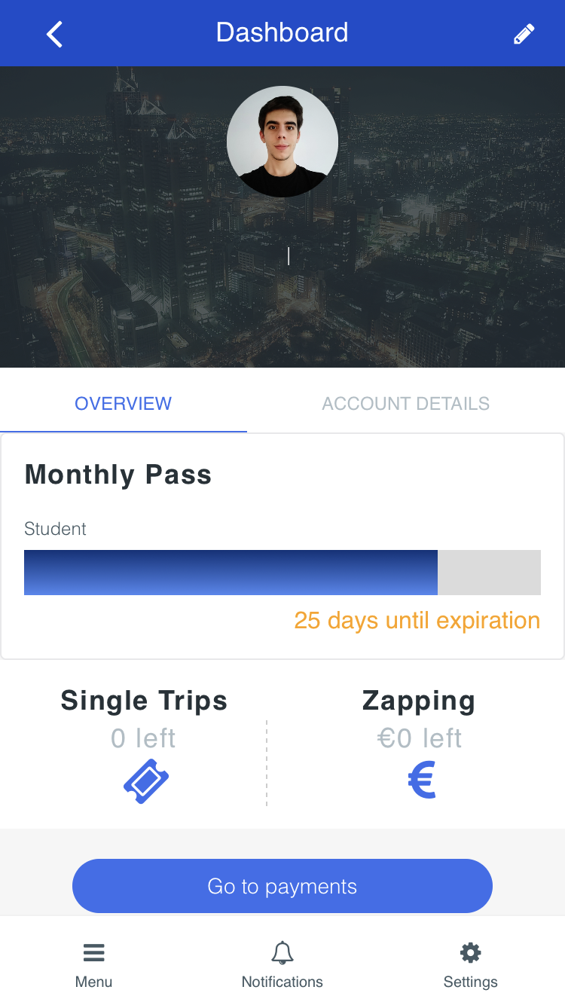
Low fiDELITY prototYPE
FORMATIVE USER TESTING AND STUDY
FUNCTIONAL PROTOTYPE

Slide 45
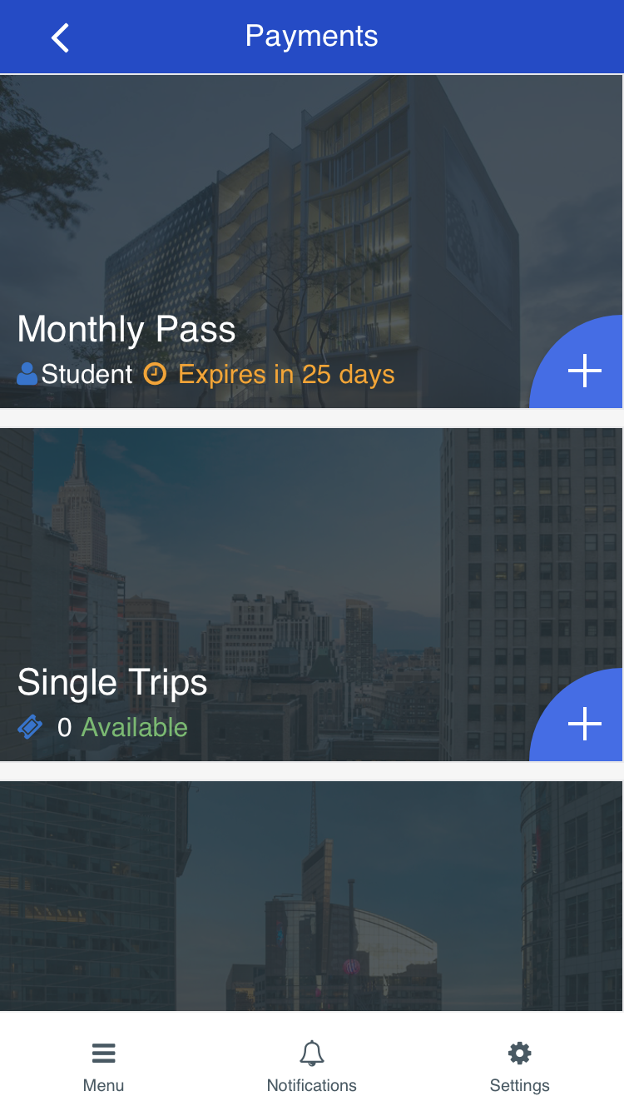
Low fiDELITY prototYPE
FORMATIVE USER TESTING AND STUDY
FUNCTIONAL PROTOTYPE

Slide 46
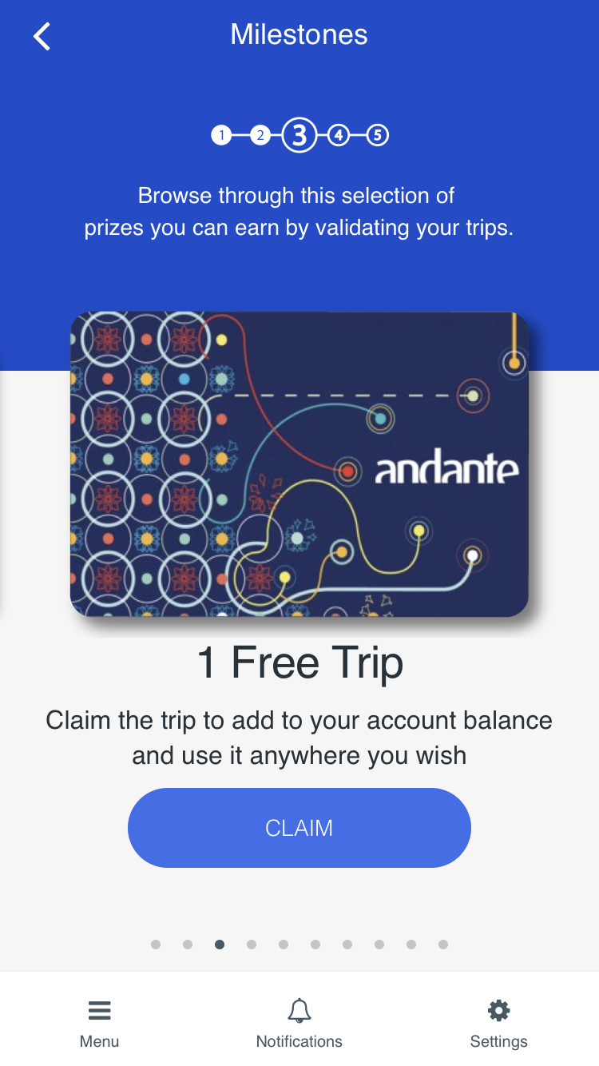
Low fiDELITY prototYPE
FORMATIVE USER TESTING AND STUDY
FUNCTIONAL PROTOTYPE

Slide 47
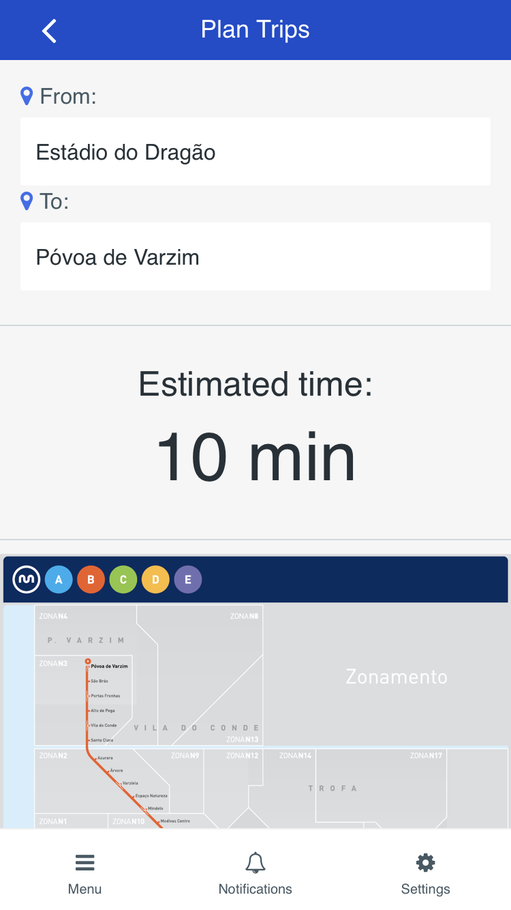
Low fiDELITY prototYPE
FORMATIVE USER TESTING AND STUDY
FUNCTIONAL PROTOTYPE

Slide 48
VIDEO

Slide 49
Live Demo

Slide 50
Q & A

